Slide 1

Project Management Masterclass Day Two

Slide 2
Project Phases
Execution
Initiation
Planning
Closure
Monitoring & Control

Slide 3

Planning Phase
Planning is thinking and deciding how to do something and only then do it, instead of doing it directly.
It is the process of analyzing, evaluating, deciding and organizing the activities in advance.

Slide 4

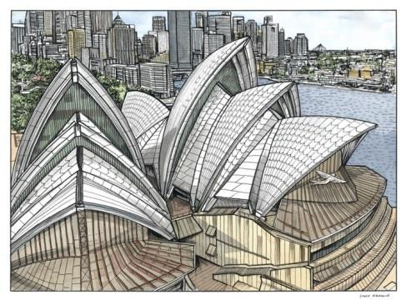
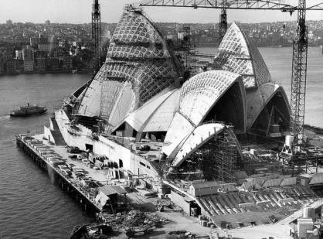
Planning Phase
Lack of proper planning and control results in delays, higher cost and/or lower quality of output.
Example: Sydney Opera
Expectations: 6 years, $ 7 Million.
Reality: 16 years, $ 102 Million.

Slide 5



The Three Fundamental Steps of Planning
1.
Define the goal
2.
Evaluate options
3.
Choose & confirm best option

Slide 6
Cost of Change
As time passes, the cost of change increases significantly. Example: Your scope is about the construction of a shopping mall. If a year after the construction has started, the owners decide it needs to be used as a residential building. The extra time and resources to transform it would be enormous. If, on the other hand, the same request comes during the planning stage, before construction has even started, the cost of the change would be much smaller (maybe a few weeks of planning).
Cost Of Change
(extra time, budget, and wasted resources due to the change)
Execution M & C
Time
Initiation
Planning
Closure

Slide 7
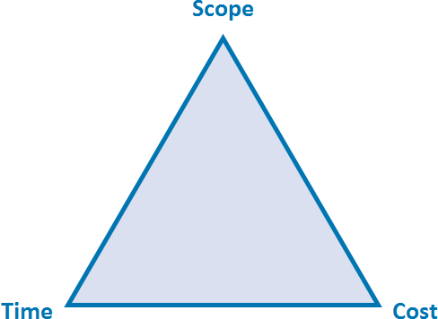
Scope

Slide 8



Scope: Broader Than Just The "Product" Of The Project
All project outputs (product, service, result)
+
Any additional work that has to be done, in order to complete the project outputs
Scope =
Example: Construction project. You need to build a house. However, there is an old smaller house on the land, on which you want to build the new one. Although the old house is not your project output, it has to be demolished and removed so that you can achieve and create your project output, which is the new house. The Scope will include the activities for demolishing and removing the old house as well.
How to plan your Scope?
1. Analyze the available information about the project scope
2. Gather detailed requirements and expectations
3. Document the scope

Slide 9


Work Breakdown Structure
The goal of the project needs to be broken down into more details so that the project manager and project team can plan and execute. If the goal is to
“increase sales by creating a showroom to exhibit new cars”, this information is too high-level and vague, hence it’s not useful for planning purposes.
The project manager has to transform this information into smaller pieces. A very useful exercise is to design the Work Breakdown Structure.
The Work Breakdown Structure (WBS) is a visual representation of the project’s Scope. Starting from the project goal (high-level), you go down a level and define the major groups of activities or “work streams”. This could be “build a one-story showroom of 500 m2”, “manufacture six new cars”, or “recruit ten employees to work as sales staff in the showroom”.
Then, add one more level below each work stream, until you reach a task level. The task needs to be big enough to be explained easily and managed by one person. Example: “Put a safety fence around the construction field”.
Project Goal
Work Stream 1
Task 1.1 Task 1.2
Work Stream 2
Task 2.1 Task 2.2
Work Stream 3
Task 3.1 Task 3.2
The sum of the detailed tasks is often referred to as an “Activity List”. It will be used as the “skeleton” of the Project Plan.

Slide 10
Time

Slide 11



Project Schedule And Timelines
A
C
B
D
4. Assign the start & end dates
Task A
+
3. Sequence tasks
Task A
2. Add buffers
1. Estimate the duration of each task

Slide 12
Start and End dates: the Gantt Chart
To the left (Y-axis), the activities are listed (you can take from the Activity list / WBS).
At the top (X-axis), a calendar is inserted. It can be with days, weeks or months, depending on what you find most convenient for the work you are planning.
The tool is a bar chart (horizontal), where each bar is limited by the start and the end date of a specific activity. The length of the bar represents the duration of the activity. All activities are listed on the side, and to the right, calendar days are displayed. With this graph, it is very easy to represent the activities and get a good feeling about the duration and when each one is to be executed.
Can be used for monitoring, but is also extremely helpful during the planning phase.
Strongly suggest using it when forming the project schedule.
Activity foundations prep works | Month |  | September |  |  |  |  | October |  |  |  | November |  |  |  | December |  |  |  |  | January |  |  | February
 | Date | 9/3 | 9/10 | 9/17 | 9/24 | 10/1 | 10/8 | 10/15 | 10/22 | 10/29 | 11/5 | 11/12 | 11/19 | 11/26 | 12/3 | 12/10 | 12/17 | 12/24 | 12/31 | 1/7 | 1/14 | 1/21 | 1/28 | 2/4 | 2/11 | 2/18
 | week n | 1 | 2 | 3 | 4 | 5 | 6 | 7 | 8 | 9 | 10 | 11 | 12 | 13 | 14 | 15 | 16 | 17 | 18 | 19 | 20 | 21 | 22 | 23 | 24 | 25
position the door frames
showroom floor works
build walls
install bathrooms
build roof
install doors and windows
install lights and complete ceiling works
Install pipes (utilities)
Paint outside walls
decorate and position interiors
recruit personnel
train personnel
select and order cars for the showroom
delivery of cars
Position cars in the showroom

Slide 13

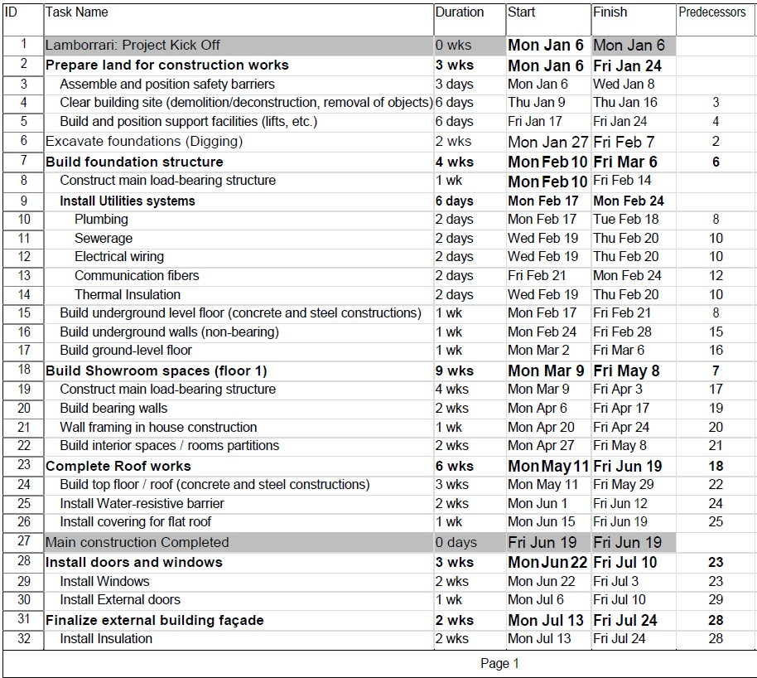



Building the Project Plan
Project Plan (or Schedule)
Activity List
Durations
(incl. buffers)
Task A +
Critical Path
Dates
(Start & End)

Slide 14
Cost

Slide 15





Project Budget
4. Determine the project
Task A
Budget. Consolidate the estimations and calculations performed.
3. Schedule the expenses, by putting expected dates
2. Estimate the cost of each task/deliverable. Add
(look at the Gantt chart). It is very important to know when the financial resources will be needed (Time value
1. Identify the cost-
from
buffers and understand
generating activities
uncertainties.
Buffers for the Cost should be bigger than those used for the Time.
of money and Approval
the project. Start with the WBS or Activity list created.
process).

Slide 16
Project Budget 2/2
If the project has more work streams and more types of costs to incur, it is recommended to have a dedicated budget for each separate work stream or cost type.
Consolidate the budgets, displaying the totals per month. This will be the overall budget per month (or quarter or week, depending on the needs).
Project Overall Budget | 2018 |  |  |  | 2019
 | Sep | Oct | Nov | Dec | Jan | Feb | Mar | Apr
foundations prep works | $ 23,000
position the door frames | $ 1,000
showroom floor works | $ 10,000
build wals | $ 2,000 | $ 27,000 | $ 15,000
instal bathrooms |  |  | $ 7,000 | $ 13,000
build roof |  |  |  | $ 67,000 | $ 16,000
instal doors and windows |  |  |  | $ 21,000
instal lights and complete ceiling works |  |  |  | $ 24,000
Instal pipes (utilities) |  |  |  |  | $ 16,000 | $ 11,000
Paint outside wals |  |  |  |  | $ 17,000 | $ 7,000
decorate and position interiors |  |  |  |  | $ 7,000 | $ 10,000
recruit personnel |  |  | $ 4,000 | $ 3,000
train personnel |  |  |  |  | $ 5,000
select and order cars for the showroom | $ 3,600
delivery of cars |  | $ 11,000 | $ 11,000 | $ 11,000
Position cars in the showroom |  |  |  |  |  | $ 4,000
 |  |  |  |  | Total Budget (per activity)
 |  |  |  |  |  |  | $ 23,000
 |  |  |  |  |  |  | $ 1,000
 |  |  |  |  |  |  | $ 10,000
 |  |  |  |  |  |  | $ 20,000
 |  |  |  |  |  |  | $ 83,000
 |  |  |  |  |  |  | $ 21,000
 |  |  |  |  |  |  | $ 24,000
 |  |  |  |  |  |  | $ 27,000
 |  |  |  |  |  |  | $ 24,000
 |  |  |  |  |  |  | $ 17,000
 |  |  |  |  |  |  | $ 7,000
 |  |  |  |  |  |  | $ 5,000
 |  |  |  |  |  |  | $ 3,600
 |  |  |  |  |  |  | $ 33,000
 |  |  |  |  |  |  | $ 4,000
Total Budget (per Month) | $ 39,600 | $ 38,000 | $ 37,000 $ | 139,000 | $ 61,000 | $ 32,000 | $ - $ - $ 302,600

Slide 17

Conclusion
In conclusion, we learned that successful software development requires efficient project management, careful planning, and continuous monitoring throughout the development life cycle. With the right project management techniques, software development teams can achieve their objectives while meeting the project's requirements, budget, and timeline.

Slide 18


Turn challenges into opportunities.
Ask more.
QA Session

Slide 19

Anmol, Offline
See you tomorrow.

Slide 20
https://bit.ly/leaf-nepal-dm01-sub
REVIEW AND NOTE SUBMISSION

